Slide 1
HIV & AIDS
School: Shrimati Indira Gandhi SSS, Mauritius
Age group: Form 4, 13-15 yrs
Subject: Art and Design

Slide 2
Saying……………
Prevention is better than cure but for AIDS the saying goes as
Prevention is better than NO CURE

Slide 3
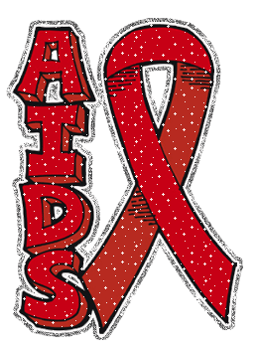
HIV – Human Immunodeficiency Virus
AIDS – Auto Immune Deficiency Syndrome

Slide 4
HIV History
HIV is thought to have entered into humans somewhere between 1914 and 1940.
In 1983, a retrovirus, now called human immunodeficiency virus (HIV), had been identified as the cause of AIDS.
The HIV antibody test has be used to screen all blood supplies in the U.S. since 1985.
People receiving blood or blood products before 1985 may have been infected.

Slide 5
Human Immunodeficiency Virus
HIV (human immunodeficiency virus) leads to AIDS (acquired immunodeficiency syndrome)
HIV can be transmitted by people with the virus who have no observable symptoms
Why some people develop AIDS more rapidly than others is unknown

Slide 6
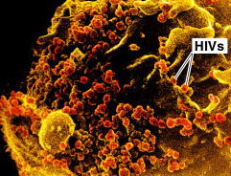
HIV and AIDS
HIV is extremely fragile and does not survive in air
AIDS is the leading cause of death for men and the fourth leading cause of death for women ages 25 to 44

Slide 7
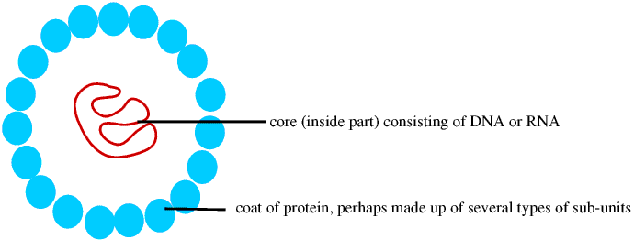
What is a Virus?
  Viruses are microbes
  They consist of -
    DNA or RNA (which hold the information about the virus, like your DNA)
    A protein coat (to protect the DNA/RNA)

Slide 8
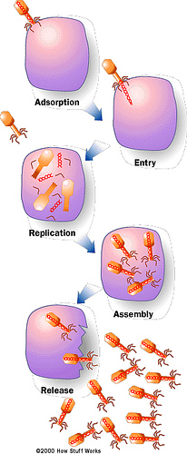
How a virus ‘works’?
A virus is a parasite which cannot reproduce on its own, it needs another living thing to survive
It infects the cells of your body and ‘hijacks’ them
(Adsorption & Entry)
Your cells stop doing what they’re supposed to and instead make copies of the virus
(Replication & Assembly)
The new viruses are released and go on to infect other cells
(Release)

Slide 9
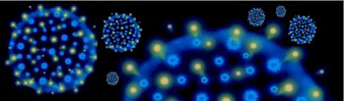
Summary (HIV)
HIV is a virus
HIV works by infecting the cells of living organisms. (damaging the immune system)
The infected cells will then replicate (make copies).
The HIV then spreads.
People with HIV are known to be HIV positive.

Slide 10
Continue...
• HIV affects your immune system (the way your body fights illness and infection)
• HIV stops your immune system from working properly so that your body can no longer defend itself. This is AIDS.
When you have HIV your immune system is damaged, meaning your body struggles to fight off other infections (e.g. AIDS).

Slide 11
Continue…
Without medical treatment after about ten years the HIV will turn into AIDS.
Antiretroviral medication can slow down the time of change between HIV and AIDS.
AIDS is a killer virus and once diagnosed with it you are most likely to die very quickly.
There is no cure.

Slide 12
How is HIV passed on?
You can only be infected with HIV through another person with the virus. HIV is found in the blood and the sexual fluids of an infected person, and in the breast milk of an infected woman.

Slide 13
Continue…
Here are ways you can catch the virus:
Having unprotected sex with an infected person.
Close contact with an infected person’s blood.
Use of infected blood.
Mother to child - a mother with HIV giving birth to a child or a child drinking the mothers milk.
Tattoos/body piercing if equipment is not clean.
Sharing razors- if blood is present
Sharing used drug needles

Slide 14
How is HIV not spread?
Sharing crockery and cutlery.
Insect/animal bites.
Touching, hugging or shaking hands.
Eating food prepared by someone with HIV.
Toilet seats.
Kissing
Kissing someone with HIV on the cheek does not pose any risk of you catching the disease. However ‘in mouth’ kissing does have a very low risk and there has been one incident. However, both of those peoples gums were bleeding.

Slide 15
HIV/AIDS in Mauritius
In 2010, about 9000 Mauritians were living with AIDS.
Recent Statistics
Population 1,250,882
People Living with HIV/AIDS 13,000
Adult HIV/AIDS Prevalence Rate 1.7%

Slide 16
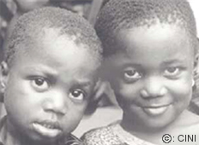
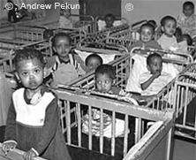
HIV/AIDS in Africa
Sub-Saharan Africa is the region of the world that is most affected by HIV & AIDS. An estimated 25.8 million people were living with HIV at the end of 2005 and approximately 3.1 million new infections occurred during that year. In just the past year the epidemic has claimed the lives of an estimated 2.4 million people in this region. More than twelve million children have been orphaned by AIDS.
During 2009, an estimated 1.3 millions Africans died from AIDS. Almost 90% of the 16.6 million children orphaned by AIDS live in Sub- Saharan Africa.

Slide 17
Can HIV be cured?
NO! Drugs are available to manage the disease, but HIV stays in the body forever!
PROBLEM: RNA viruses mutate at a very high rate. A person with HIV under control can evolve resistance to the drug treatments.
Some infected persons have several strains of HIV in their bodies.

Slide 18
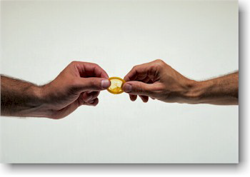
Cures & Prevention
There is no actual cure for HIV & AIDS. However there are ways you can prevent yourself from catching the virus in the first place, or slowing down the transmission from HIV to AIDS.
You can prevent yourself from getting AIDS by using contraception when having sex with people who are HIV+ and not coming in close contact with their blood.
If you already have HIV you can use antiretroviral medication, which slows the progression from HIV to AIDS and keeps some people healthy for many years.

Slide 19



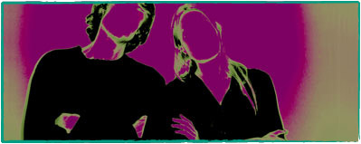
How to protect yourself from HIV?
Use condom
Abstinence
Mutual monogamy

Slide 20
Quiz on AIDS
Press on the link below

