Slide 1
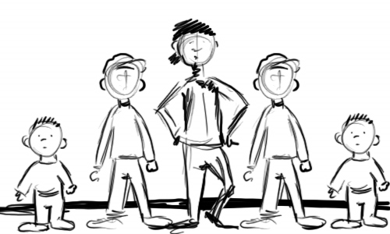
WHO ARE ADOLESCENTS BY S2k. Gayaza high-Uganda

Slide 2
Definition
The term adolescent refers to the people between the ages of 10-19 years (United Nation Population Fund, 1998) although some writers put it at
12-19. it is a time of rapid change and difficult challenges.
Adolescents face a wide variety of psychological demands as well: becoming independent from parents, developing skills in interacting well with their peers, devising a workable set of ethical principles, becoming intellectually competent and acquiring a set of social and personal responsibility.

Slide 3
SO ALL OF US IN THIS PROJECT FROM GAYAZA ARE ADOLESCENTS, WHAT ABOUT OUR PEERS FROM MAURITIUS AND US

Slide 4
2. Emotional changes
Very shy
Sensitive and easily annoyed
Aggressive and rebellious
Demand independence and neglect norms and values
Too emotional and easily cry
Sexual emotions develop and become sensitive about the way they sit, walk and eat
Easily excited and upset
Concerned about appearance that’s why they use powder, mirrors etc
Some rude and coarse while others calmand polite in speech

Slide 5
General changes (Emotional)
Recognition
Identification
Moody
Need love
Freedom
Horny urge for sex
Inquisitive

Slide 6
3. Cognitive/Psychological changes
Curiosity
Ape/copy
Adventurous
Argumentative/all knowing
Creative
Dominance

Slide 7
4.Social changes
Easily misled into bad habits by peers e.g. smoking, alcoholism etc
Inferiority complex especially when the friend they associate with is more beautiful, richer, and so makes them feel out of place
Wanting to seek for recognition, may end up in trouble e.g. expulsion or being punished
As some become shy, they fail to express themselves in public
Poor relationship with parents because of demand for independence and break into quarrels with them

Slide 8
Social changes continued
Affected by STDs because of fornication
Some become unruly and aggressive to authority because of failure to agree to school rules
Sexual harassment in homes and schools by people who take advantage of them
Fail to balance academics and social life and so end up declining
Feel old enough and so want to run away from home
Affected by Western influence, education and so become disloyal to parents, school, church and society

Slide 9
EFFECTS (General)
Experimentation (phones, Mp3, iPods Surfing, movies, reading)
Model inspiration/imitation (musicians such as Jay-z Beyonce, Rihanah etc, footballers such as Messi, Ronaldo etc, actors such as Salvador)
Social activities (dancing/clubs, outings/parties)
Debates/arguments
Style look outs and hair styles, dress/fashion
Win/ win paradigm
Independent
Start relationships
Want respect
quarresome

Slide 10
Irresponsible sexual behavior
Having unprotected sexual intercourse
Pressuring a partner into sexual intercourse
Failure to accept one’s emotions or feelings
Sexual harassment
Promiscuity
Rape
All these can lead to HIV AIDS

Slide 11
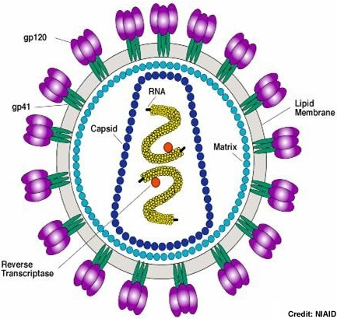
Consequences
Unplanned pregnancy
Risk of contracting HIV/AIDS
Loss of self esteem due to guilt
Feeling sad or useless increases chances of HIV contraction
Dropping out of school
Continue to receive misleading and confusing sexual information

Slide 12
What we expect from teachers’ role
The teachers need to provide basic and practical skills to guide and counsel adolescents so as to deal with development changes and challenges in order to realize their potential and life goals
Teachers can empower adolescents take informed decisions to effectively cope with emotions related to their sexuality that put their health at risk

Slide 13
Teachers’ role continued
Counseling and guidance – sex education
Inspire and focus on the virtue/values
mentoring and coaching
Be exemplary/role models
Understand the students and appreciate them
Emphasize on the spiritual/religious values
Involve parents and make follow ups

Slide 14
THANK YOU

